Slide 1
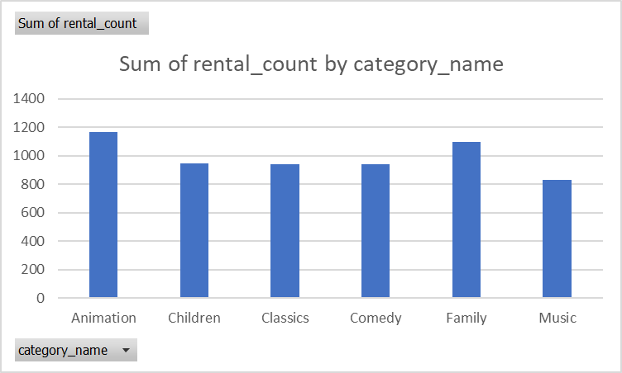
What was the rental count by categories considered family movies?
<visualization>
Animation movies were rented the most while Music movies were rented the least for categories considered family movies

Slide 2
What were the number of movies classified by duration quartile ?
Most of family movies were in 3rd and 4th standard quartile which meant that family movies had long duration. Animation movies dominated the 1st and 4th standard quartile explained animation movies had either very short or very long duration.

Slide 3
What was the monthly payment by top 10 paying customers ?
Based on the data, top 10 paying customers paid the most in April and March. While, May was the least payment month. Highest one month payment which was just over $100 made by Eleanor Hunt

Slide 4
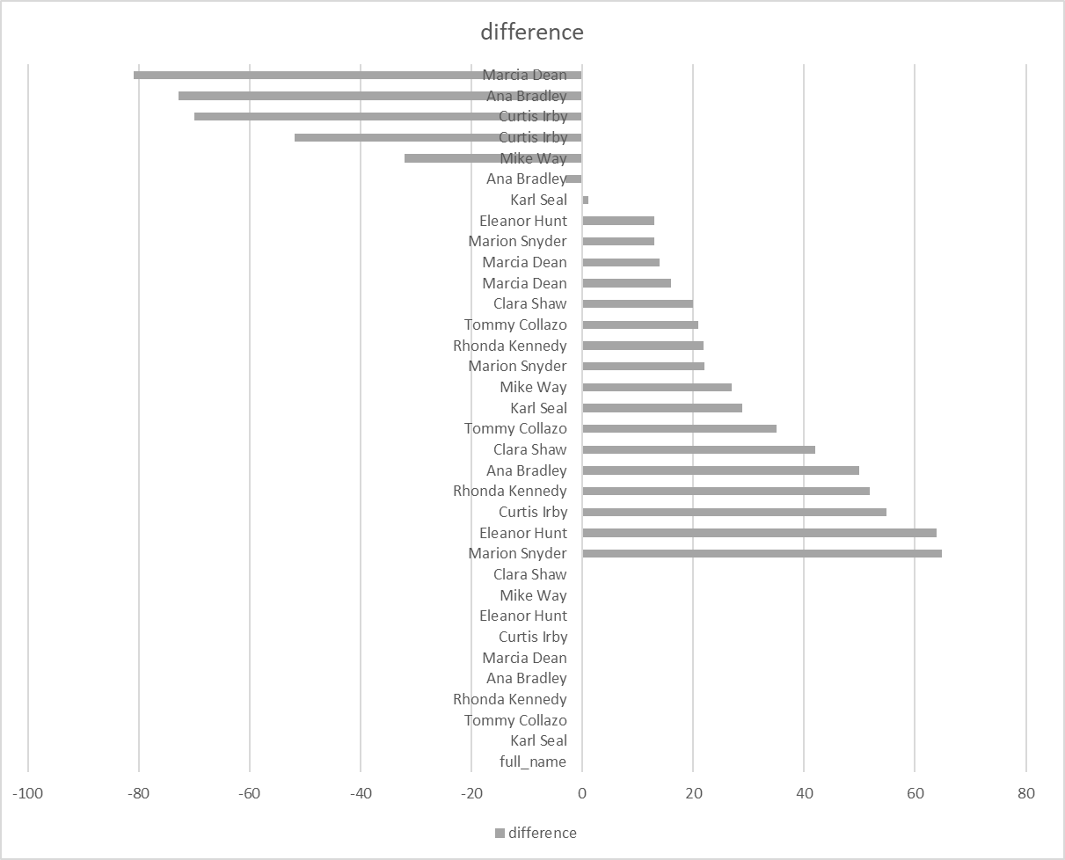
Which customer had the largest month over month difference in payment?
Based on the graph, Marion Dean had the largest drop in payment month by month which was more than $80. While Eleanor Hunt had the highest increase in payment month by month which was close to $65

